Slide 1
Physical Education
Open
house
Mrs. Collazo

Slide 2
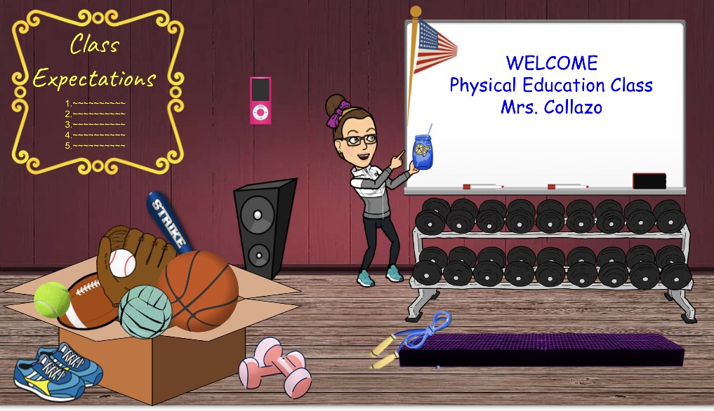
Mrs. Collazo
PreK-8th Grade
Vsher-Collazo@yonkerspublicschools.org

Slide 3
Class Expectations
Show up on time
Find a quiet place with no distractions
Be prepared if equipment or props are requested
Wear sneakers whenever exercising
Mute when the teacher is presenting. Click raise hand to be called on.
Be respectful and Kind to others

Slide 4
Assignments
There will be one assignment each week for the students.
Assignments will be posted on my teacher page each week.
Assignments can be emailed back to me, or posted on the chat on teams.
Assignments may be physical activity or a written assignment.

Slide 5
Websites
For physical education we will be using a few different websites to assess information.
PreK and K will be using SeeSaw, with additional recourses available on my teacher page.
Grades 1-8 will be using Microsoft Teams as well as my teacher page for assignments posted each week.
Additional websites used are go noodle, AHA, youtubePE, shape America and open PE.

